Slide 1
DOM AND EVENT LISTENERS

Slide 2
DOM (Document Object Model)
Represents all page content as objects that can be modified.
The document object is the main “entry point” to the page. We can change or create anything on the page using it.
For instance:
// change the background color to red document.body.style.background = "red";
// change it back after 3 seconds
setTimeout(() => document.body.style.background = "", 3000);

Slide 3
DOM tree
The backbone of an HTML document is tags.
According to the (DOM), every HTML tag is an object.
Nested tags are “children” of the enclosing one
The text inside a tag is an object as well.
All these objects are accessible using JavaScript, and we can use them to modify the page.
For example, document.body is the object representing the <body> tag.
See previous example

Slide 4
An example of the DOM
Let’s start with the following simple document:
<!DOCTYPE HTML>
<html>
<head>
<title>About elk</title>
</head>
<body>
The truth about elk.
</body>
</html>

Slide 5
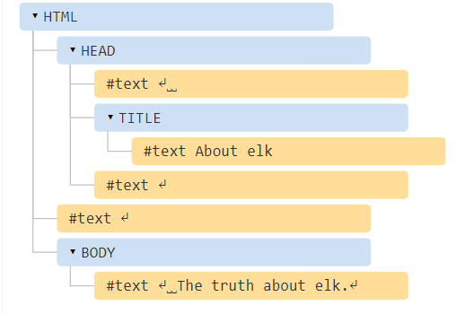
DOM TREE STRUCTURE

Slide 6
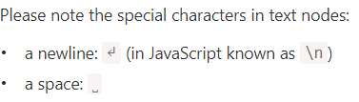
CONTINUED…
Tags are element nodes (or just elements) and form the tree structure: <html> is at the root, then <head> and <body> are its children
The text inside elements forms text nodes, labelled as #text
A text node contains only a string. It may not have children and is always a leaf of the tree.

Slide 7
CONTINUED…
NOTE: Spaces and newlines are totally valid characters, like letters and digits.
TOP LEVEL EXECUTIONS IN DOM
Spaces and newlines before <head> are ignored for historical reasons
If we put something after </body>, then that is automatically moved inside the body, at the end, as the HTML spec requires that all content must be inside <body>. So there can’t be any spaces after </body>.

Slide 8
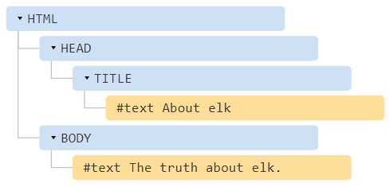
TREE STRUCTURE OF DOM (NO SPACES)
<!DOCTYPE HTML>
<html><head><title>About elk</title></head><body>The truth about elk.</body></html>

Slide 9
SOME FEATURES OF DOM
Autocorrection
If the browser encounters malformed HTML, it automatically corrects it when making the DOM.
E.g the top tag is always <html>. Even if it doesn’t exist in the document, it will exist in the DOM, because the browser will create it.
Tables always have <tbody>
HTML text always omits the <tbody> tag but DOM will always include it in its structure i.e after <table> but before <tr>

Slide 10
OTHER NODE TYPES
Review, elements and text nodes.
Others are
1. COMMENTS
This node type will node appear with the text node, it’s a rule that if something is in HTML then it also must be in the DOM tree
2. <!DOCTYPE…>
It’s in the DOM tree right before <html>
3. Document object
Forms the entry point into DOM

Slide 11
VIEWING THE DOM
1. USE THE LIVE DOM VIEWER
Live DOM Viewer
http://software.hixie.ch/utilities/js/live-dom-viewer/
2. use the browser developer tools.
THEN switch to Elements tab
NB The DOM structure in developer tools is simplified.
3. Right click on a webpage and select “inspect”

Slide 12
Interaction with console
As we work the DOM, we also may want to apply JavaScript to it.
The last selected element is available as $0
We can run commands on them.
For instance,
$0.style.background = 'red’ //makes the selected list item red
Changes made are temporary ,will be lost every time the browser is reopened

Slide 13
How To Access Elements in the DOM
Gets | Selector Syntax | Method
ID | #demo | getElementById()
Class | .demo | getElementsByClassName()
Tag | demo | getElementsByTagName()
Selector (single) |  | querySelector()
Selector (all) |  | querySelectorAll()
CONSIDER THE EXAMPLES BELOW
<div id="demo">Access me by ID</div>
<div class="demo">Access me by class (1)</div>
<article>Access me by tag (1)</article>
<div id="demo-query">Access me by query</div>
<div class="demo-query-all">Access me by query all (1)</div>

Slide 14
Accessing Elements by ID
In order to be accessed by ID, the HTML element must have an id attribute
E.g
<div id="demo">Access me by ID</div>
document.getElementById(); method is used in this case
Eg const demoId = document.getElementById('demo’);
console.log(demoId);
demoId.style.border = '1px solid purple';

Slide 15
Accessing Elements by Class
The class attribute is used to access one or more specific elements in the DOM.
document.getElementsByClassName(); method is used
eg
<div class="demo">Access me by class (1)</div>
<div class="demo“>Access me by class (2)</div>
const demoClass = document.getElementsByClassName('demo’);
//since it has a number of objects with same class(use array approach)
for (i = 0; i < demoClass.length; i++) {
demoClass[i].style.border = '1px solid orange';
}

Slide 16
Accessing Elements by Tag
A less specific way to access multiple elements on the page would be by its HTML tag name
document.getElementsByTagName(); is used
Eg having <article>Access me by tag (1)</article>
<article>Access me by tag (2)</article>
const demoTag = document.getElementsByTagName('article');
for (i = 0; i < demoTag.length; i++) {
demoTag[i].style.border = '1px solid blue';
}

Slide 17
Query Selectors
Syntax
document.querySelector();
document.querySelectorAll();
To access a single element, you can use the querySelector() method
Eg <div id="demo-query">Access me by query</div>
//Selector to an id is #
const demoQuery = document.querySelector('#demo-query’);
demoQuery.style.border = '1px solid red';

Slide 18
document.querySelectorAll();
The selector for a class attribute is a period or full stop (.)
Eg <div class="demo-query-all">Access me by query all (1)</div>
<div class="demo-query-all">Access me by query all (2)</div>
const demoQueryAll = document.querySelectorAll('.demo-query-all');
Using the forEach() method, you can apply the color green to the border property of all matching elements. demoQueryAll.forEach(query => {
query.style.border = '1px solid green';
});

Slide 19
Modifying the DOM with Events
An event in JavaScript is an action the user has taken.
When the user
submits a form
clicks on an element
presses a specific key on the keyboard
these are all types of events.

Slide 20
EXAMPLES OF EVENTS
MOUSE EVENTS
Mouse events are among the most frequently used events
They refer to events that involve clicking buttons on the mouse or hovering and moving the mouse pointer.
These events also correspond to the equivalent action on a touch device.

Slide 21
EXAMPLE OF MOUSE EVENT
Create an html document
In it create a button e.g
<button id="changeBackground">Change Background Color</button>
Create scripts.js and link it to your html
In js assign your button to a variable i.e
let button = document.getElementById('changeBackground’);
Using the addEventListener() method, we will tell the button to listen for a click, and perform a function once clicked.
button.addEventListener('click', () => {
document.body.style.backgroundColor = ‘green';
});

Slide 22
CONTINUED…
Event | Description
click | Fires when the mouse is pressed and released on an element
dblclick | Fires when an element is clicked twice
mouseenter | Fires when a pointer enters an element
mouseleave | Fires when a pointer leaves an element
mousemove | Fires every time a pointer moves inside an element

Slide 23
Form Events
Form events are actions that pertain to forms, such as input elements being selected or unselected, and forms being submitted.
Event | Description
submit | Fires when a form is submitted
focus | Fires when an element (such as an input) receives focus
blur | Fires when an element loses focus

Slide 24
CONTINUED…
Focus is achieved when an element is selected, for example, through a mouse click or navigating to it via the TAB key.
JavaScript is often used to submit forms and send the values through to a backend language.
The advantage of using JavaScript to send forms is that it does not require a page reload to submit the form
JavaScript can be used to validate required input fields.

Slide 25
EXAMPLE OF FORM EVENT
<form onsubmit="alert('submit!');return false"> First: Enter in the input field
<input type="text" value="text"><br>
Second: Click "submit":
<input type="submit" value="Submit">
</form>

Slide 26
EXAMPLE 2 ON FOCUS
<!doctype html>
<html>
<body>
<p>Click on the input field to set focus.</p>
<input type="text" id="my-input">
<script>
var myInput = document.querySelector('#my-input');
myInput.addEventListener('focus', function() {
console.log(You focused on me.');
});
</script>
</body>
</html>

Slide 27
Keyboard Events
Keyboard events are used for handling keyboard actions, such as pressing a key, lifting a key, and holding down a key.
Event | Description
keydown | Fires once when a key is pressed
keyup | Fires once when a key is released
keypress | Fires continuously while a key is pressed

Slide 28
DIFFERENCE BETWEEN THE EVENTS
keydown and keypress events do not access all the exact same keys
keydown will acknowledge every key that is pressed
keypress will omit keys that do not produce a character, such as SHIFT, ALT, or DELETE.

Slide 29
PROPERTIES FOR ACCESSING INDIVIDUAL KEYS
Two properties that pertain to keyboard objects include key and code.
Eg if the user presses the letter a key on their keyboard, the following properties pertaining to that key will surface:
PROPERTY | DESCRIPTION | EXAMPLE
key | Represents the character name | a
code | Represents the physical key being pressed | KeyA

Slide 30
CONTINUED…
The key property is the name of the character, which can change
E.g pressing a with SHIFT would result in a key of A

Slide 31
EXAMPLE OF KEY EVENTS
Create a basic HTML file with <p> tags and load it into a browser.
i.e
<body>
<p> </p>
</body>

Slide 32
ADD A JS FILE REFERENCING TO THE SELECTOR
document.addEventListener('keydown', event => {
var element = document.querySelector('p’);
// Set variables for keydown codes
var a = 'KeyA’;
var s = 'KeyS’;
var d = 'KeyD’;
var w = 'KeyW’;
//CONTINUED NEXT SLIDE

Slide 33
CONTINUED
// Set a direction for each code
switch (event.code) {
case a:
element.textContent = 'Left’;
break;
case s:
element.textContent = 'Down’;
break;
case d:
element.textContent = 'Right’;
break;
case w:
element.textContent = 'Up’;
break;
}
});

